Slide 1
Testing Overview

Slide 2
Why testing ?
Because development is not always exactly done as required. We call the differences as bugs.
And it’s highly likely, that as long as humans are developing software, we are continuously going to face bugs.

Slide 3
The definition
A software bug is an error, flaw or fault in a computer program or system that causes it to produce an incorrect or unexpected result, or to behave in unintended ways.

Slide 4
Bugs a.k.a. …
Defects
Fault
Problem
Error
Incident
Anomaly
Failure
Inconsistency
Feature :-)

Slide 5
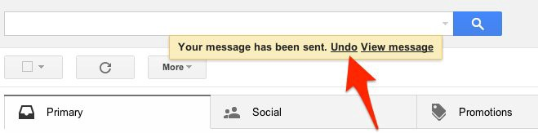
Defect as a feature :- )
Assignment 1: Read for the best bugs converted to features
https://bit.ly/3vCkfsa

Slide 6
But mostly, bugs are bad, and need to be removed as soon as identified.
They have cost us lives, and loss of millions of dollars.
They have caused delays in flights to delays in major satellite launching.
They have made self driving cars crash.
Assignment 2: Read about biggest failures due to bugs
https://bit.ly/30O9OGy

Slide 7
Sources of Bugs
Requirements Definition: Erroneous, incomplete, inconsistent requirements.
Design: Fundamental design flaws in the software.
Implementation: Mistakes in chip fabrication, wiring, programming faults, malicious code.
Support Systems: Poor programming languages, faulty compilers and debuggers, misleading development tools, server.

Slide 8
Sources of Bugs (Cont’d)
Inadequate Testing of Software: Incomplete testing, poor verification, mistakes in debugging.
Evolution: Sloppy redevelopment or maintenance, introduction of new flaws in attempts to fix old flaws, incremental escalation to inordinate complexity.

Slide 9
Goal of a software tester
… to find bugs
… as early in the software development processes as possible
… and make sure they get fixed.

Slide 10
Where does testing occur in the software development process?
Basically everywhere, let’s see how.

Slide 11
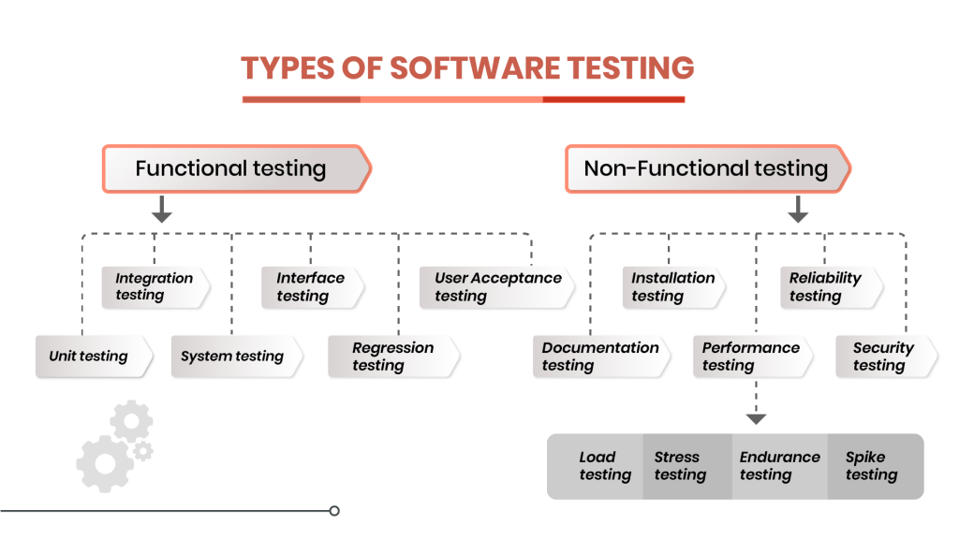

Slide 12
Assignment 3:
Read in a little detail for different types of testing
https://ehikioya.com/forums/topic/understanding-the-different-types-of-software-testing/

Slide 13
Types of Testing(context: Code visibility)
Black box testing: Code, structure of the application and it’s implementation is not visible to the tester. Tester has to validate results with expected values only. Eg. API Testing by QA team.
White box testing: Code is visible in white box testing. Eg. Unit testing by dev team.
Grey box testing: Code, structure of the application and it’s implementation is partilly visible.

Slide 14
Types of testing (context: functionality)
Functional: Tests that the application is producing results as expected.
Non Functional: Tests that application is working. Eg. Testing for performance, load, stress, security…

Slide 15
Assignment 4:
Identify what type of testing is done in SOAP UI tool.
Identify what type of testing is done with JMeter tool .

Slide 16
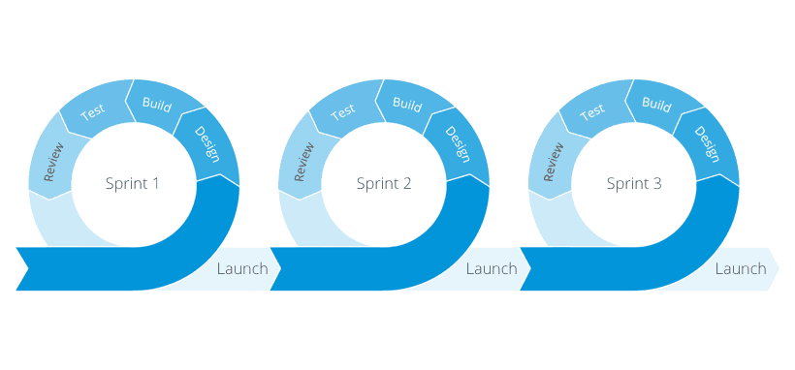
Testing in Agile methodology
Regression testing for old cycles.
Integration testing for new cycles.

Slide 17
Types of Testing (Context: Effort)
Manual testing: without help of any tool, manually going through the application components one by one and looking for bugs.
Automation testing: Leveraging use of tools, that are capable to mimic manual process of testing.

Slide 18
Advantages of automation
Cost-Saving
Fast Development and Delivery
Increased Productivity
More Accurate Tests
Immediate report generation & Feedback.
CI/CD and DevOps Implementation

Slide 19
When to automate ?
When you have to run same test cases again and again. (Regression Testing)
When you have to run same test case for different data sets.
(Data driven testing)
When ROI is good for test design via automation.

